Slide 1
Emerging Issues
David Gustafson
gusta002@umn.edu

Slide 2
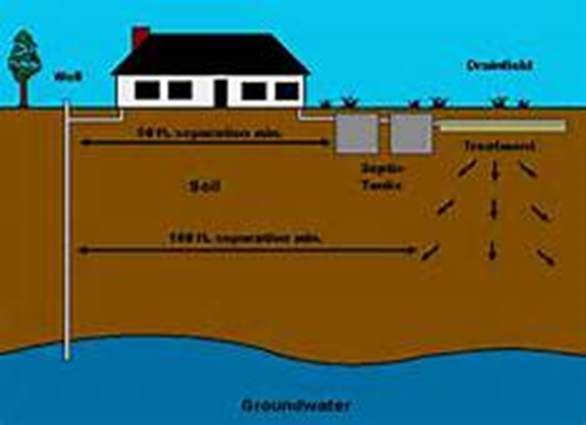
Industry Goals
Longterm
Treatment
Affordable

Slide 3
What are the Issues
Treatment concerns
System operation
System care
Industry Changes

Slide 4
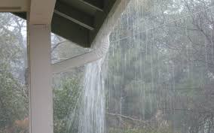
Climate Change
Heavier rains
Warmer temperatures
Higher Groundwater levels
Greater variation
Treatment concern

Slide 5
Electrochemical Assisted Anaerobic Digestion
Power
Biogas
Power supply
Electrodes

Slide 6
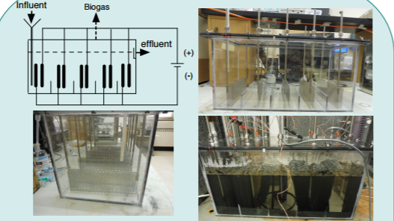
Experimental set-up
20 Liter reactor of the modified septic tank with electrodes
Schematics including electrodes position and connections
Photograph of empty reactor
Reactor treating wastewater
The effect of increasing the Eap to 0.6 V and 0.7 V is being evaluated

Slide 7
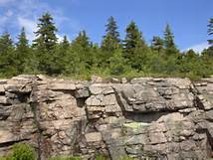
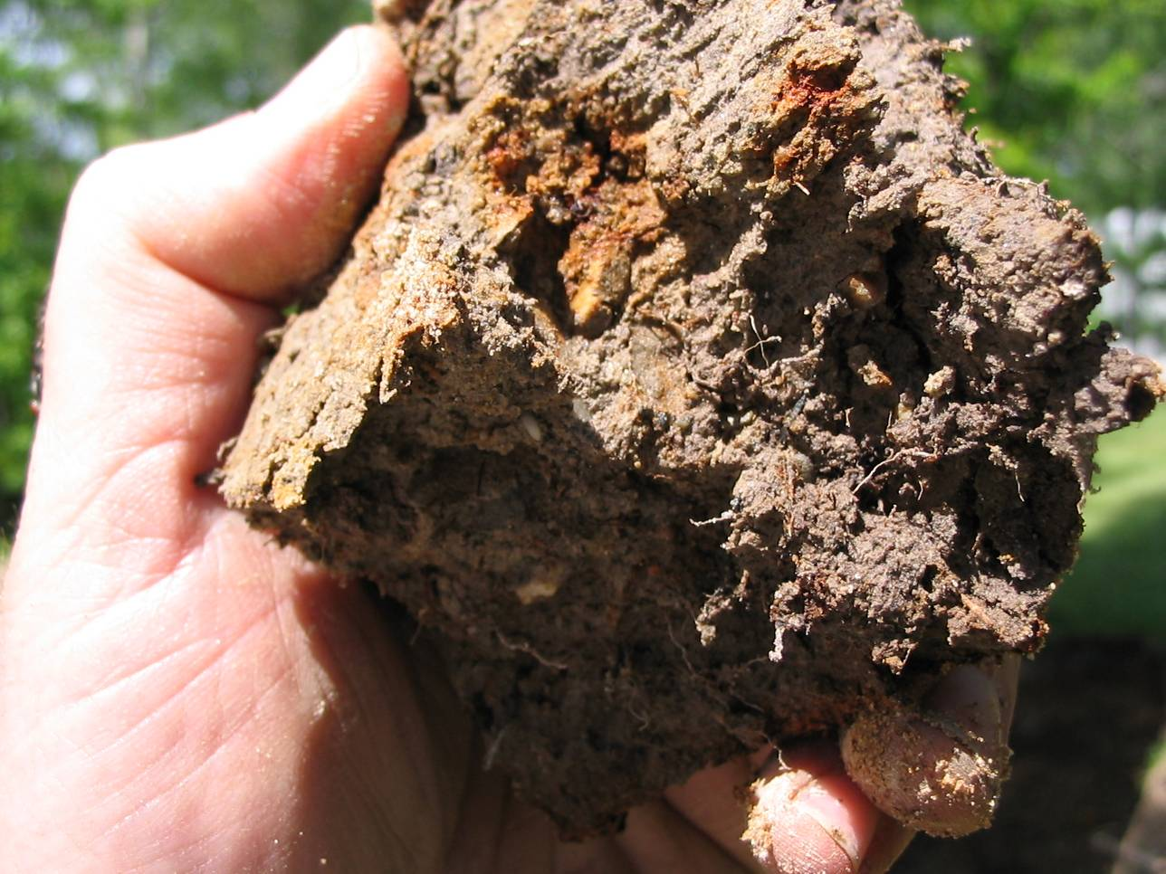
Limiting Conditions
Saturated Soils
Bedrock
Sandy soils
Rocky Soils

Slide 8
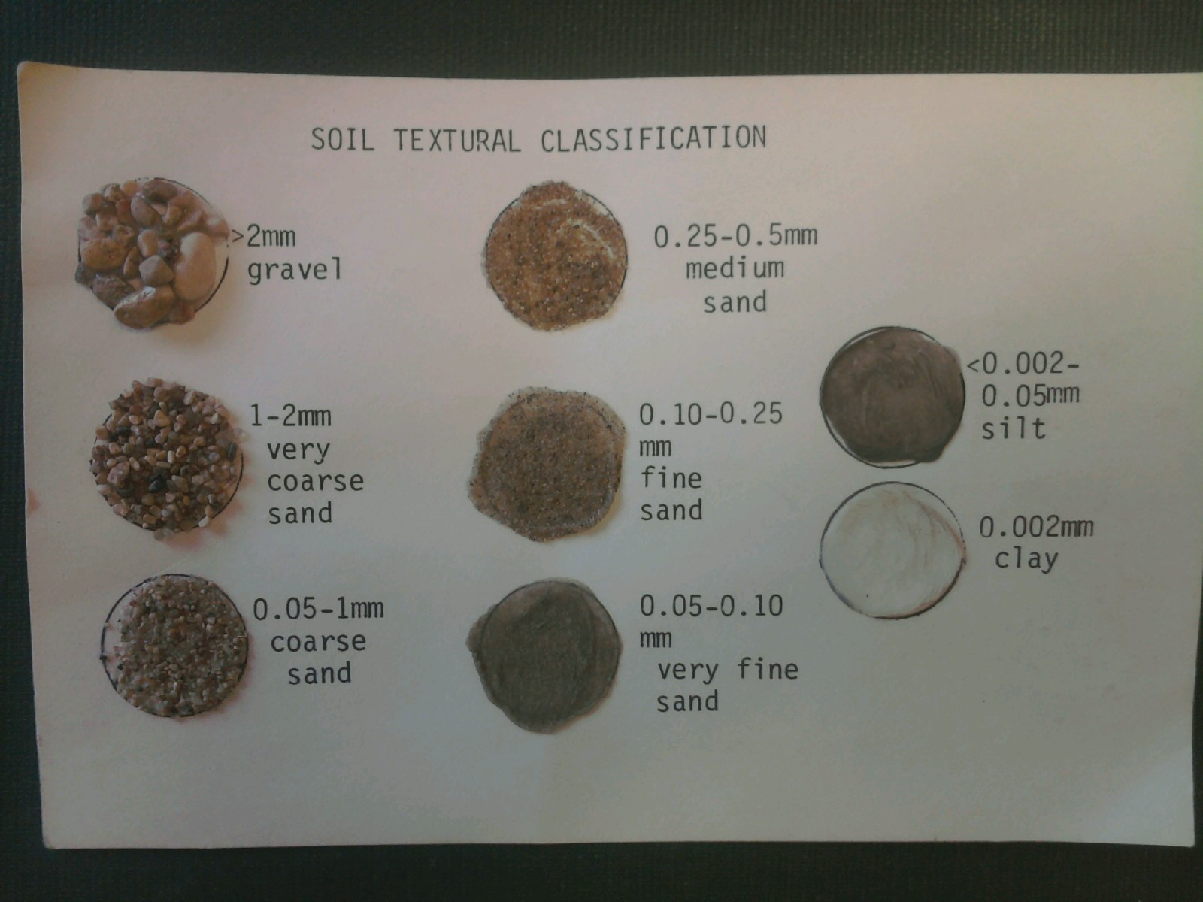
More than 50% 2mm or greater = bedrock
~A very thin wedding band is 2 mm
$10
Onsite Sewage Treatment Program
University of Minnesota

Slide 9
Saturated vs Unsaturated Flow
Unsaturated for treatment
LTAR
SAR
Saturated for speed
Hydraulic conductivity
Perc test or Soil Characteristics
BOTH

Slide 10
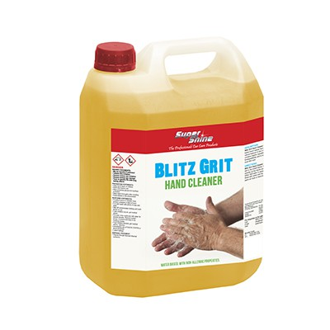
Surface water Protection
Surface discharge
Prescription drugs
Grit
Treatment concern

Slide 11
Ground water protection
Water treatment
RO
Iron filters
Softeners
System Compliance
Treatment concern

Slide 12
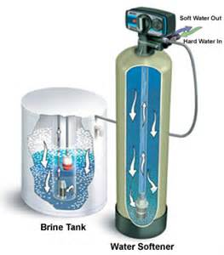
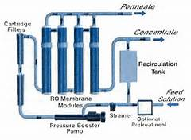
Water Conditioning
Softeners
Iron filters
RO Units

Slide 13
Early Research
Septic Tank/Water Softener “Potential Effects of Water Softener Use on Septic Tanks Soil Absorption On-Site Wastewater Systems”
University of Wisconsin-Madison
“The Effect of Home Water Softener Waste Regeneration Brines on Individual Aerobic Wastewater Treatment Plants”
NSF International
Notes:
The University of Wisconsin study was conducted to test the hypothesis that if softener discharge harms a septic tank’s performance it would show up in the septic tank effluent clogging the soil systems or otherwise interfering with its performance.
The NSF study was conducted to measure the impact of salt from water softener discharge on biological action in the septic system, and to determine if the volume and flow rate of the discharge could overwhelm septic systems

Slide 14
Recent Studies
Novak et. al, VA Tech findings in regard to Industrial Aerobic Activated Sludge systems:
An imbalance in the monovalent to divalent (M/D) cation ratio can lead to poor settling
This had not been tested in anaerobic systems.
Poor settling and lack of clear zones may be due to excessive sodium (M) in relation to calcium (D) and magnesium (D).
Notes:
Note to self: Novak presented his work at the WERF workshop.

Slide 15
Study Goals
Look at amount and capture of suspended solids
Look at ability to separate layers and quality of effluent
Illustration from www.genie.com
Notes:
Will apply to advanced treatment systems, too, because primary treatment is anaerobic with secondary treatment being aerobic for polishing or further treatment of the waste water.

Slide 16
Outcomes
More research
Choosing “Better Units”
No Brine
Flow based
Time based – Potential issues
Softener Care
Be careful with Advanced technologies

Slide 17
System Specifics
Design & Layout
Special wastes
HSW
Hard to treat

Slide 18
Closed restaurant [Really Famous Dave’s ~ 20 seats and 15 seats in bar] wants to reopen and add patio seating [22 more seats]
System Loading

Slide 19
Design Confusion
Residential
Assume BOD, TSS Loading
Estimated use [Bedrooms]
Non-Residential
Higher Organic loading
THE CODE
Care facilities
VRBO

Slide 20
Flow Changes
Check “Old Design”
New Numbers
20 Seats [Food] x 30 gpd
15 Seats [Bar] x 36 gpd
22 Seats [Patio] x [30-36] gpd
11 Employees x 15 gpd
2,000 gpd
600 gpd
540 gpd
660-792 gpd
165 gpd
1,965-2,097 gpd

Slide 21
Tank Sizing
Remember “Grease trap”
Typically 1 times the Kitchen flow
70% total flow
2,000 x 70% =
Septic tank: 3 x Design flow
2,000 gpd x 3 days =
Or 4 times and skip grease trap
1,400 gal
6,000 gal
8,000 gal

Slide 22
System Sizing
After service check STA loading
Measured flow ~ 890 gpd
Measured BOD5 ~ 755 mg/L
# BOD5 = Flow x Conc. X 8.35÷1,000,000
890 gpd x 755 mg/L x 8.35÷1,000,000
5.6 lbs

Slide 23
Soil Organic Loading Rate
SOLR = # ÷ Sqft
5.6 # ÷ 2,000 Sqft
Too High
0.003
2,000 sqft
Table 5.1 SOLR—Bottom Area Only
SHLR | lbs of BOD/ ft²/day of total absorption area | lbs of TSS/ft²/day of total absorption area | lbs of FOG/ft²/day of total absorption area
Sand [1.2] | 0.0017 | 0.0006 | 0.0003
Sandy Loam [0.78] | 0.0011 | 0.0004 | 0.0002
FS, Loam [0.6] | 0.0009 | 0.0003 | 0.0001
Silt Loam [0.5] | 0.0007 | 0.0003 | 0.0001
Clay Loam [0.45] | 0.0006 | 0.0002 | 0.0001
3,333 sqft
0.002
Too High

Slide 24
Solutions
More Area
# of BOD5 ÷ SOLR
5.6 ÷ 0.0009 #/sqft=
Pretreatment
6,222 sqft

Slide 25
Sizing Issues~ Solutions
Backward Design
Area Limited
Contour Limited
Treatable Design flow
Flow equalization

Slide 26
CLR Example~ Good Site
Good site with only a 40’ contour available
Recommended CLR = 12 gpd/ft
Design flow = Contour length x CLR
Design flow = 40 ft x 12 gpd/ft
Timer setting = 70% of Design flow
Timer setting = gpd x .7 [70%]
480 gpd
336 gpd

Slide 27
Example~ Ugly Site
Perc rate 133 mpi
Ugly site with only a 40’ contour available
Recommended CLR = 6 gpd/ft
Design flow = Contour length x CLR
Design flow = 40 ft x 6 gpd/ft
Timer setting = 70% of Design flow
Timer setting = gpd x .7 [70%]
240 gpd
170 gpd

Slide 28
Example: Limited width
5 Bedroom Type I home
Site with Clay [88 mpi] and an available area of 35’ x 40’ on the site
35’
40’
3%

Slide 29
Clay [88 mpi]
5
MAR~
CLR = Width ÷ MAR
CLR = 40’ ÷ 5
System Max Flow = Length x CLR
System Max Flow = 35’ x 8 gpft
Timer Setting = 70% of Max flow
Timer Setting = gpd x .7
8 gpft
280 gpd
196 gpd

Slide 30
The Industry
Unknowns
MRSA Bacteria
Current practices
Land Application
Business Transition
Work force age

Slide 31
Safety
OSHA
Excavation focus
Pathogens
MRSA
Methicillin-resistant Staphylococcus aureus
Anti-biotic Resistant

Slide 32
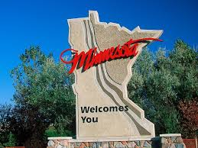
Today’s Regulations
Relationships
Understanding
Two Parties
Moving forward
MN example

Slide 33
Questions

